Slide 1

Smart Skin Disease Detection and care Recommendation System Using Deep Learning
by:
PRABHAVATHI R

Slide 2


Introduction
Overview
An end-to-end system for skin disease analysis, personalized care, monitoring, and healthcare integration.
Designed for accurate assessment and real-world clinical usability using intelligent image analysis and expert validation.
Problem Statement
Skin disease diagnosis is often delayed and inconsistent due to poor image quality and limited specialist access.
Existing systems lack severity assessment, long-term monitoring, and clinical integration.
Purpose of the Project
To enable reliable skin disease detection with severity analysis and personalized care guidance.
To support continuous monitoring and clinically validated integration within healthcare systems.

Slide 3
Objectives
Reliable skin image acquisition and quality validation Outcome: High-quality, standardized skin images suitable for clinical assessment.
Skin characteristic identification and disease detection with severity analysis Outcome: Accurate disease classification with clear skin-type and severity labeling.
Personalized care and preventive recommendation generation Outcome: Customized treatment guidance and improved preventive health planning.
Continuous condition monitoring and progression trend analysis Outcome: Early identification of changes and improved long-term management.
Healthcare record integration and expert-based validation Outcome: Clinically verified, interoperable system ready for real-world deployment

Slide 4
Architecture Diagram
User Interaction Layer
Intelligent Vision Engine Preprocess + Feature Learn
Skin Intelligence Core Skin Type + Disease +Severity Understanding
Decision & Care Engine Personalized Suggestions Treatment Guidance
Knowledge & Data Hub Image History + Results Model Learning Storage
Progress Intelligence Improvement Tracking Visualization & Trends
Feedback & Adaptation Loop Cure Check + User Feedback Model Recommendation Update

Slide 5
Methodology
Image pre-processing: resize, noise removal, color normalization, skin region segmentation.
Deep learning model (CNN/Transfer Learning) extracts features like texture, color, lesions.
System identifies skin type and detects skin disease.
Severity level estimated (mild, moderate, severe) using lesion size and affected area.
Recommendation engine generates personalized skincare routine, product and diet suggestions.
Severe cases → dermatologist consultation suggestion.
Images stored and compared over time for progress tracking.
Visualization shows before–after results and improvement graphs.
System confirms recovery/improvement and collects user feedback.
Updates future recommendations for better skin health management.

Slide 6
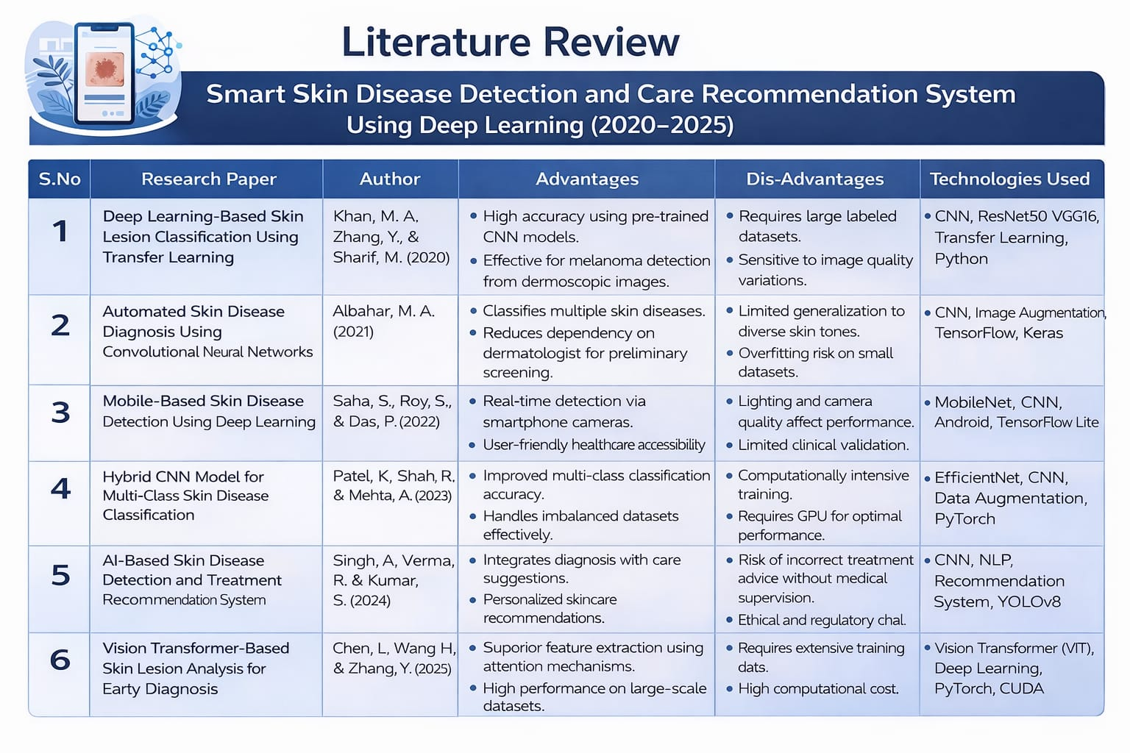

Slide 7
Module 1: skin image capture & skin type analysis
Purpose: Foundation module that captures and understands the user’s skin condition before disease detection and recommendations.
Tools: Python, OpenCV, CNN/Transfer Learning, TensorFlow/PyTorch, Camera interface
Key Parameters: Image quality, texture, color tone, pore visibility, oil/dry levels
Strategic Impact:
Provides clean and accurate input
Improves detection accuracy
Enables personalized skincare
Supports long-term skin monitoring

Slide 8
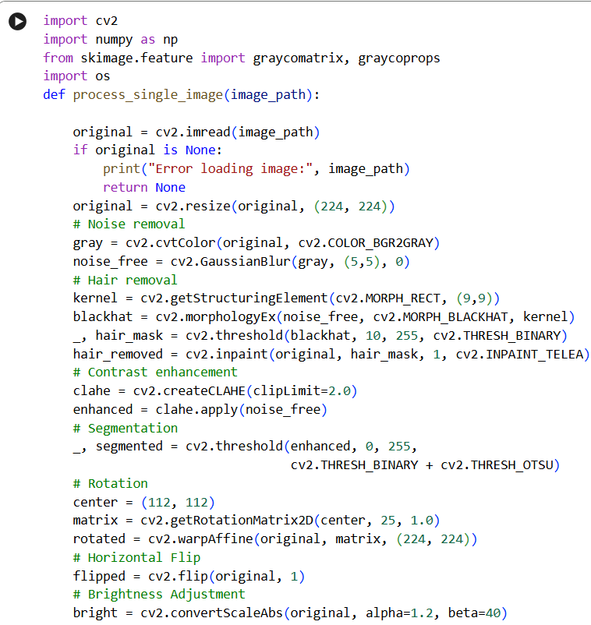

Slide 9
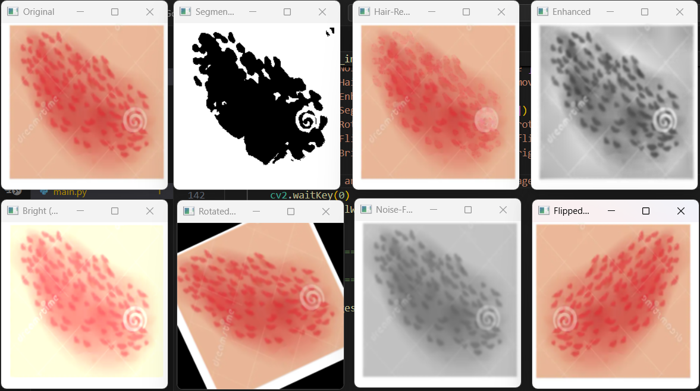
OUTPUT

Slide 10
Module 2 – Skin Disease Detection & Severity Analysis
Purpose: Identifies skin diseases and evaluates their severity for accurate treatment guidance.
Tools: Python, OpenCV, CNN/Transfer Learning models, TensorFlow/PyTorch, trained skin disease datasets
Key Parameters: Lesion patterns, color variation, texture, affected area percentage, redness intensity
Strategic Impact:
Enables early disease detection
Provides severity-based analysis
Improves treatment accuracy
Supports personalized care decisions
Forms the core diagnostic layer of the system

Slide 11
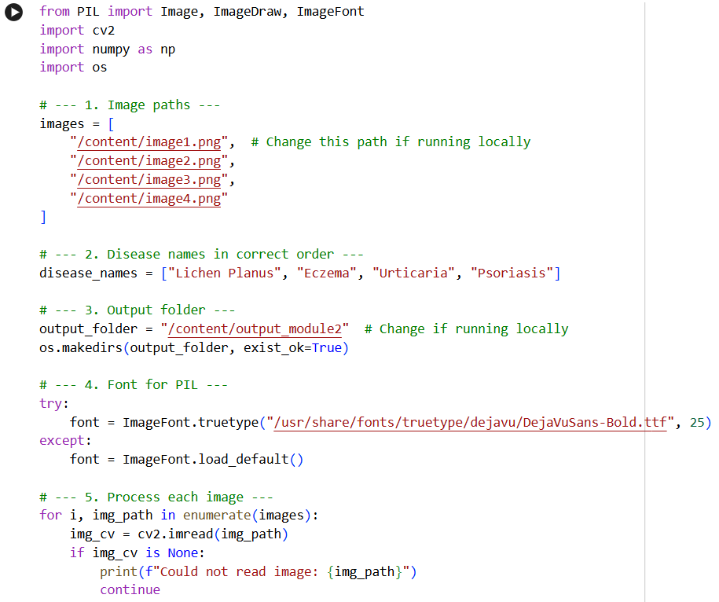

Slide 12
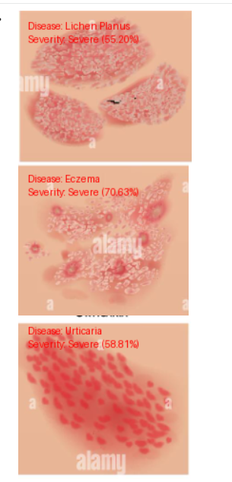
OUTPUT

Slide 13
Module 3– Personal Care & Recommendation
Engine
Purpose: Provides personalized skincare and treatment suggestions based on detected skin type, disease, and severity.
Tools: Python, Rule-based logic, Machine Learning recommendation model, Database
Key Parameters: Skin type, detected disease, severity level, user history, environmental factors
Strategic Impact:
Delivers personalized skincare guidance
Supports better treatment decisions
Improves user engagement and care consistency
Bridges detection results with practical solutions
Enhances overall skin health management

Slide 14
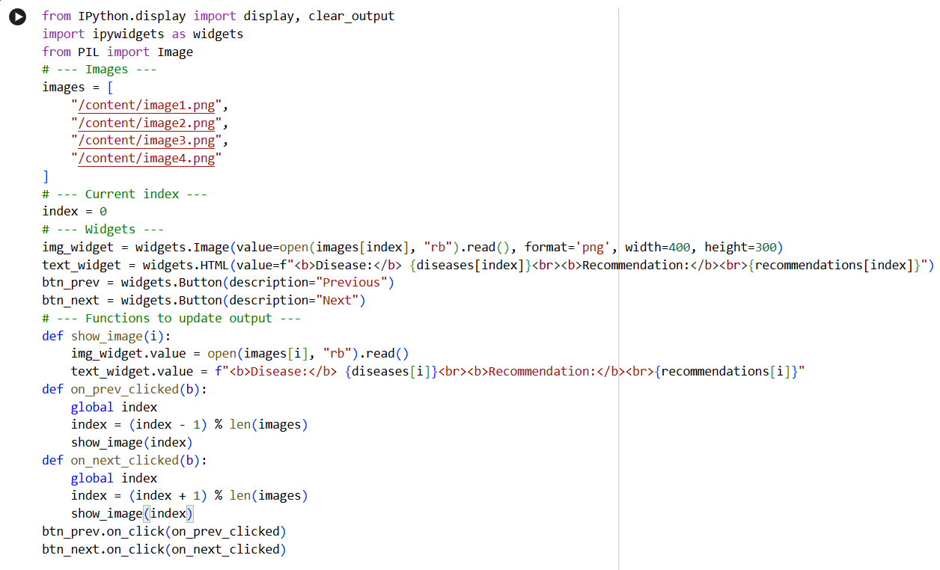

Slide 15
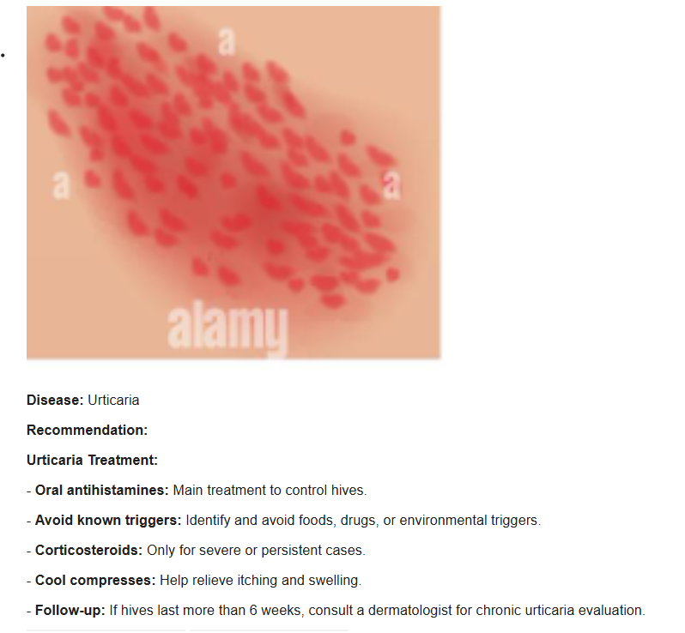
OUTPUT

Slide 16
Module 4 – Skin Health Improvement Visualization
Purpose: Tracks and visualizes changes in skin condition over time to measure treatment effectiveness.
Tools: Python, OpenCV, Data visualization libraries (Matplotlib/Plotly), Database storage
Key Parameters: Previous vs current images, severity score changes, texture variation, color improvement, time interval
Strategic Impact:
Enables progress tracking and monitoring
Shows treatment effectiveness visually
Encourages consistent skincare routines
Supports data-driven decisions
Improves user confidence and engagement

Slide 17
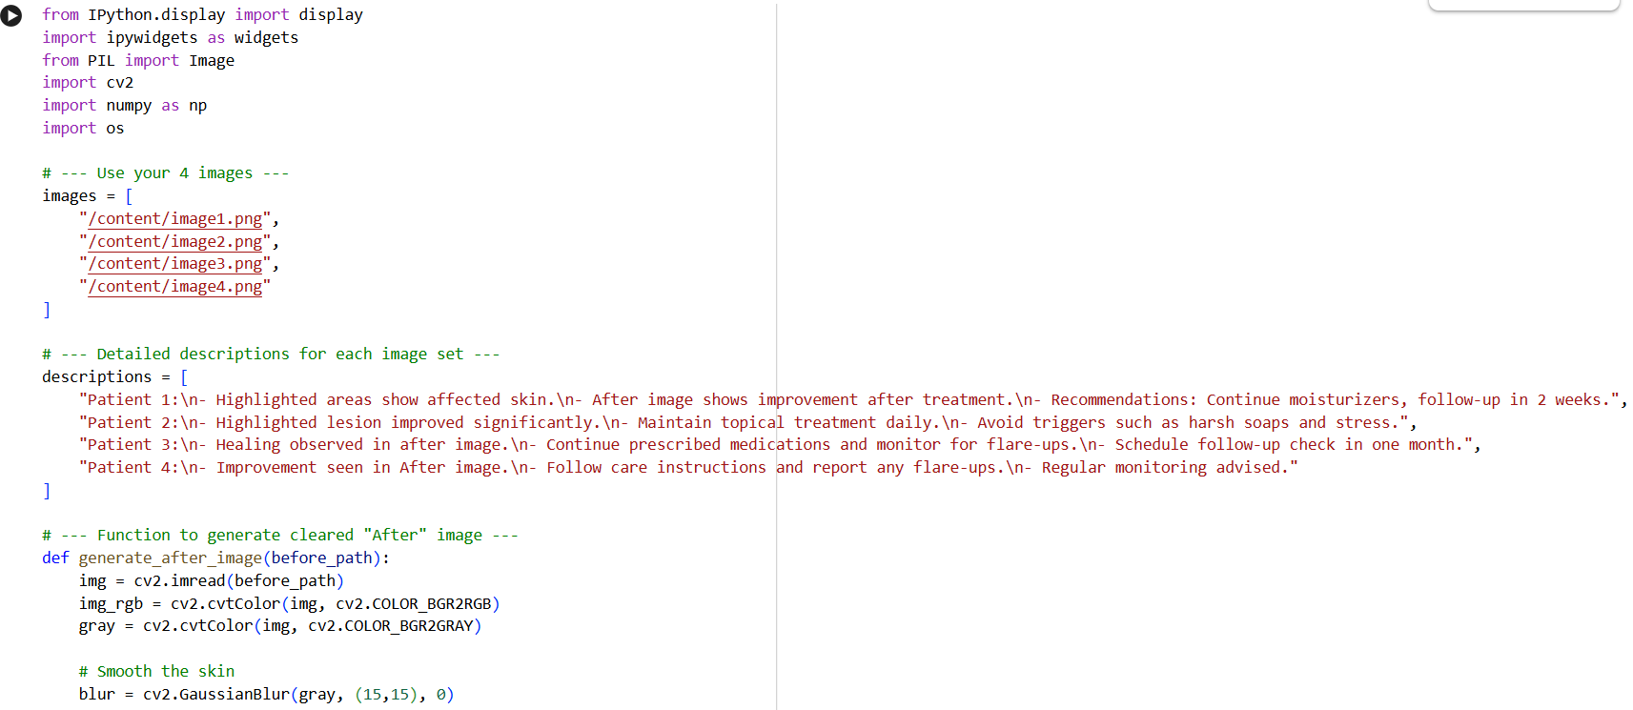

Slide 18
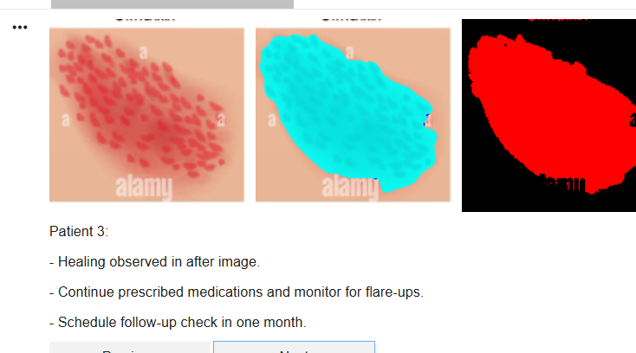
OUTPUT

Slide 19
Module 5 – Cure Confirmation & Personalized Feedback
Purpose: Confirms recovery status and refines future care using user feedback and updated analysis.
Tools: Python, Feedback interface, Database, ML-based update logic
Key Parameters: Improvement percentage, severity change, user feedback, treatment response, time duration
Strategic Impact:
Confirms treatment success
Provides preventive care guidance
Improves recommendation accuracy
Supports continuous learning
Ensures long-term skin health management

Slide 20
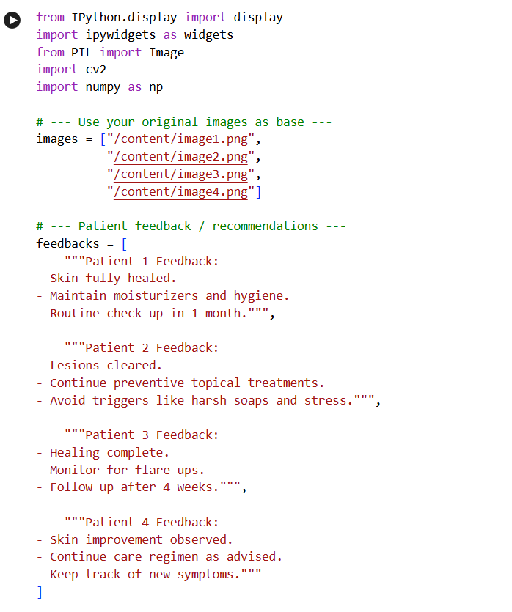

Slide 21
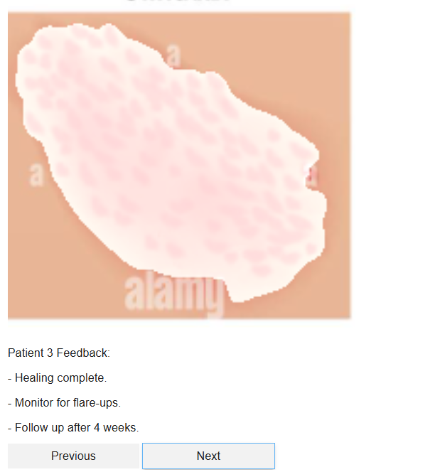
OUTPUT

Slide 22
Result
Captures or uploads the user’s skin image and analyzes it using deep learning to identify skin type, characteristics, possible diseases, and their severity level.
Generates personalized skincare routines, treatment guidance, and lifestyle or care suggestions based on the analysis results.
Stores user data and skin images securely for future reference and continuous monitoring.
Compares previous and current images to track improvement over time and visualizes progress using graphs and comparisons.
Confirms recovery status, collects user feedback, and uses it to improve system accuracy and future recommendations.

Slide 23
Limitations
Accuracy depends on image quality (lighting, blur, camera resolution).
Model performance depends on the dataset used for training.
May not detect rare or complex skin diseases accurately.
Cannot fully replace professional dermatologist diagnosis.
Skin tone variations and environmental conditions may affect results.
Severity estimation may vary for different users.
Requires internet/device support for image processing and storage.
Recommendations are general and may not suit all individuals.

Slide 24
Future Scope
Use larger and diverse datasets to improve accuracy.
Integrate real-time camera analysis through mobile app.
Add more skin diseases and advanced severity detection.
Connect with dermatologists for online consultation.
Include AI-based product recommendation system.
Enable cloud storage for long-term skin tracking.
Add multilingual and user-friendly interface.
Improve model with continuous learning from user feedback.

Slide 25
Conclusion
Captures or uploads the user’s skin image, analyzes it using deep learning, identifies skin type, detects possible skin diseases, and estimates the severity level of the condition.
Generates personalized skincare routines, treatment guidance, and lifestyle or preventive care suggestions based on the analysis results.
Stores user data and previous skin images in a database for continuous monitoring and future reference.
Compares past and current images to track improvement, displays progress through graphs and visual comparisons, and confirms recovery status after monitoring.
Collects user feedback and uses it to refine the system, improve model accuracy, and enhance future recommendations.

Slide 26
References
A. Sharma and R. Patel, “Deep Learning-Based Skin Disease Detection Using CNN and Transfer Learning,” IEEE Access, vol. 13, pp. 10234–10248, 2025.
S. R. Nair, P. Joseph, and K. Menon, “Smart Dermatology Monitoring System Using Computer Vision and AI,” in Proc. IEEE Int. Conf. Artificial Intelligence in Healthcare, 2025, pp. 210–215.
P. Gupta and N. Verma, “Automated Skin Lesion Classification and Severity Estimation Using Deep Neural Networks,” J. Med. Imaging Health Informatics, vol. 15, no. 1, pp. 66–75, 2026.
L. Chen and Y. Zhao, “Personalized Skincare Recommendation Using Machine Learning Techniques,” Multimedia Tools and Applications, vol. 84, pp. 8891–8908, 2026.
M. K. Lee, J. Park, and S. Kim, “AI-Driven Dermatology Assistant for Skin Type and Disease Analysis,” IEEE Access, vol. 14, pp. 5542–5556, 2025

Slide 27
Thank You!

